Slide 1
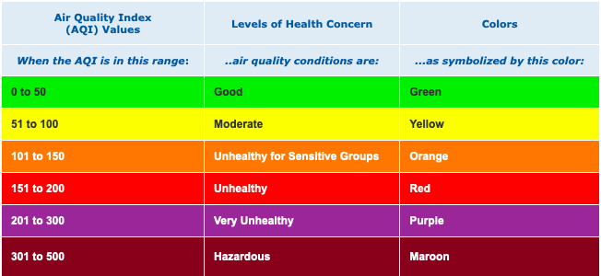
An Examination of the Measurement and Correlations of Air Quality
Team von-Neumann
Abby Lemon
Alan Riveros
Brandon Uhler

Slide 2
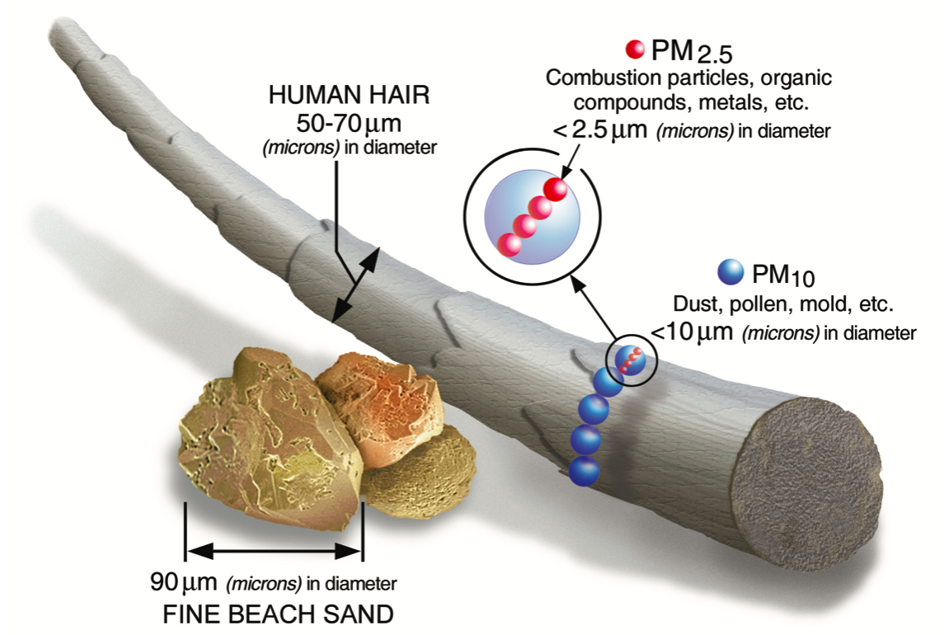
https://www.epa.gov/sites/production/files/2016-09/pm2.5_scale_graphic-color_2.jpg

Slide 3
How Does Environment Affecting Air Quality?
Is there a relationship between the population of an area and its air quality?
Is there a relationship between yearly PM2.5 and temperature?
Is there a relationship between real time PM2.5 and temperature?

Slide 4
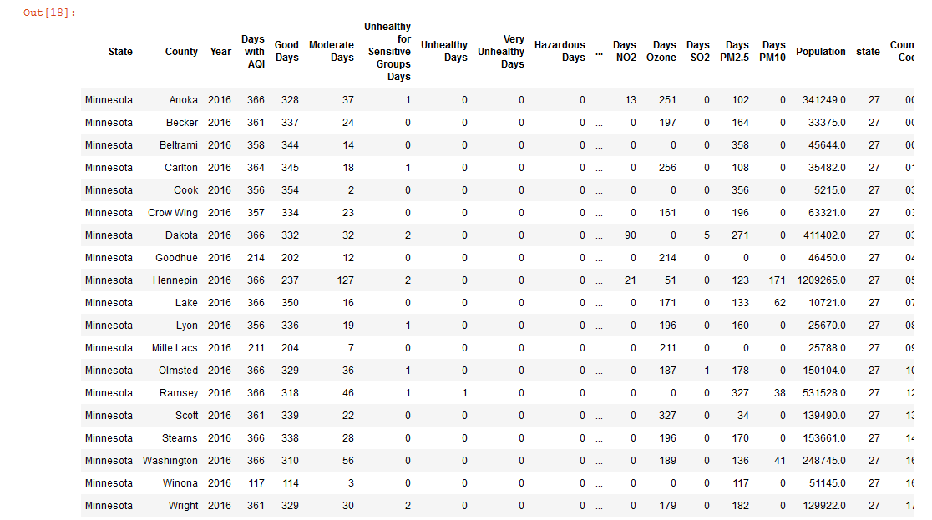
Data Manipulation
Demonstrating correlation can be achieved by plotting the data* using a scatterplot
To achieve this, a data frame containing county population and air quality information would be ideal
*Population provided by Census API and EPA data provided by the EPA’s AirData database

Slide 5
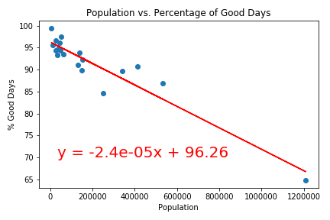
Population and Air Quality in 2016
After plotting population (along the x) and air quality (along the y) we can perform a linear regression analysis on the data to evaluate the potential correlation
The metric used for air quality is the percentage of “good days” of a county

Slide 6
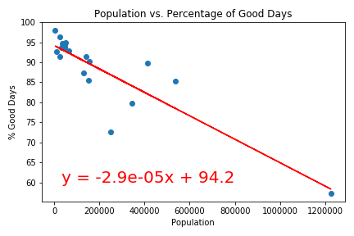
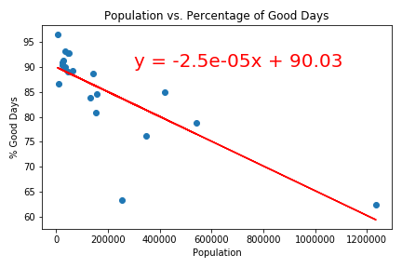
2016 2017 2018
R2 = 0.8899
R2 = 0.7655
R2 = 0.6004

Slide 7
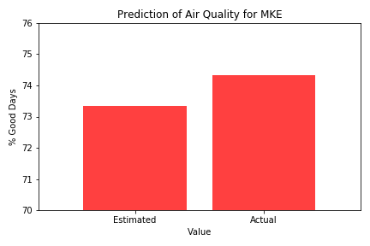
Predicting Air Quality
Using the result of the linear regression from Minnesota’s 2016 data, we can evaluate its ability to forecast
Using the same method as before, Milwaukee’s air quality for 2016 is estimated

Slide 8
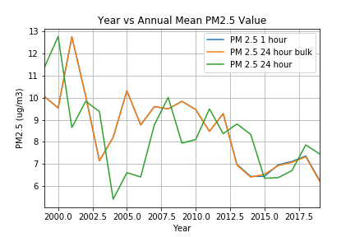
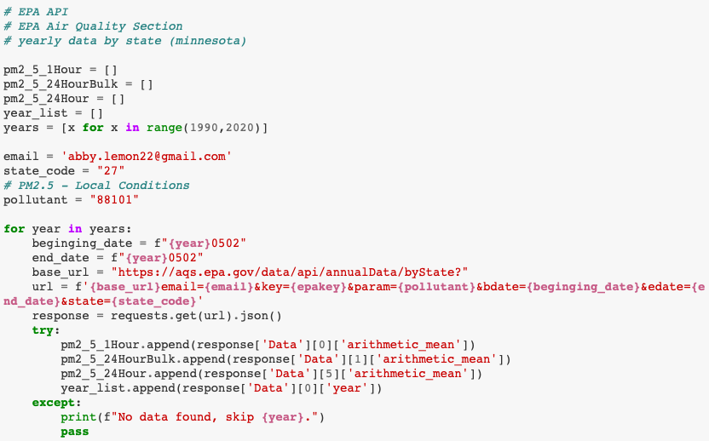
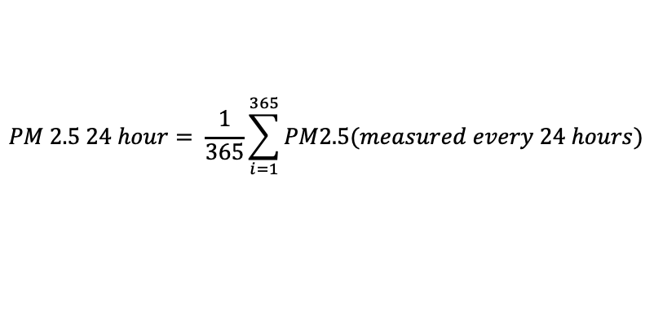
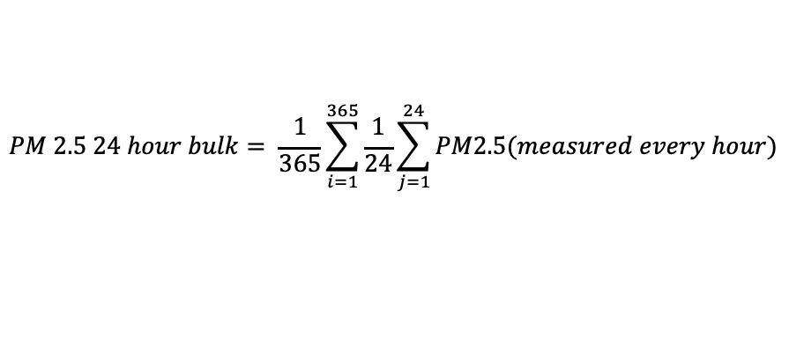
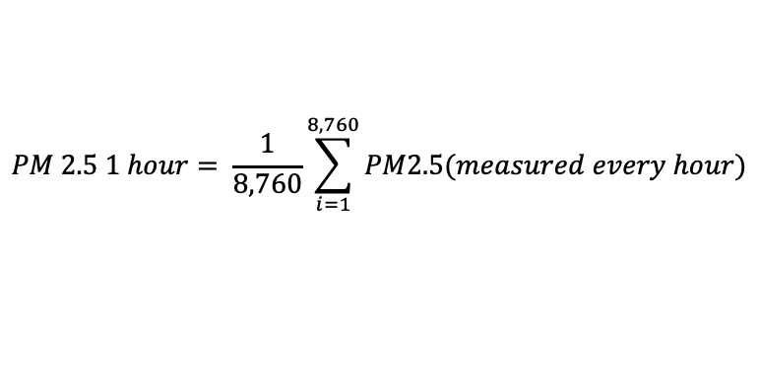
Yearly EPA PM2.5 API Data
$$PM 2.5 1 hour= \frac{1}{8,760}\sum_{i=1}^{8,760}{PM2.5(measured every hour)}$$
$$PM 2.5 24 hour bulk= \frac{1}{365}\sum_{i=1}^{365}{\frac{1}{24}\sum_{j=1}^{24}{PM2.5(measured every hour)}}$$
$$PM 2.5 24 hour= \frac{1}{365}\sum_{i=1}^{365}{PM2.5(measured every 24 hours)}$$

Slide 9
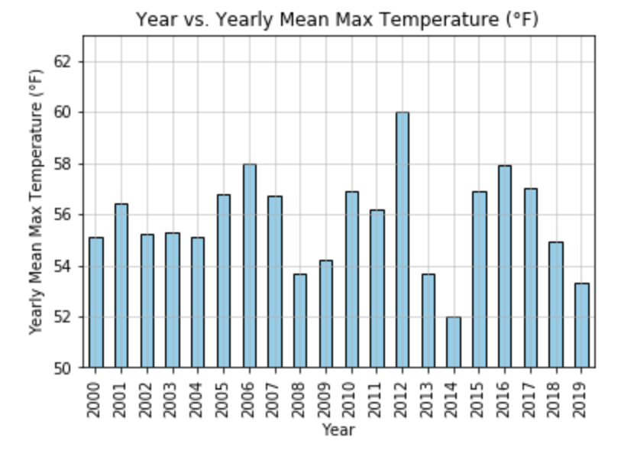
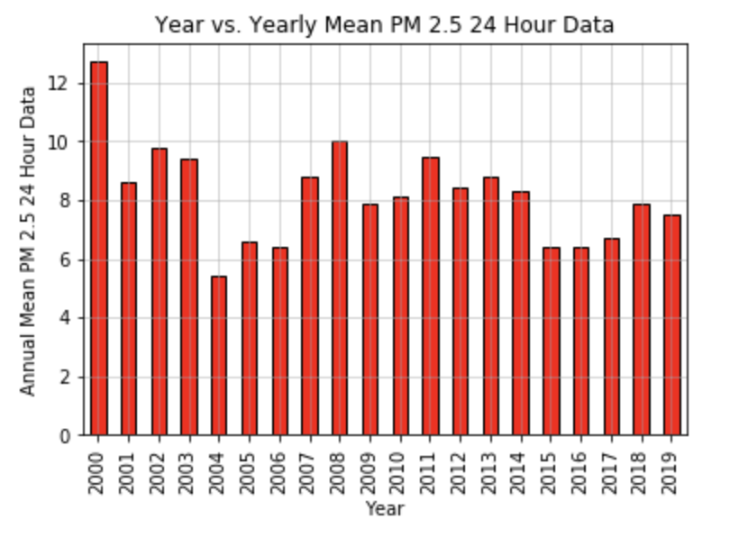
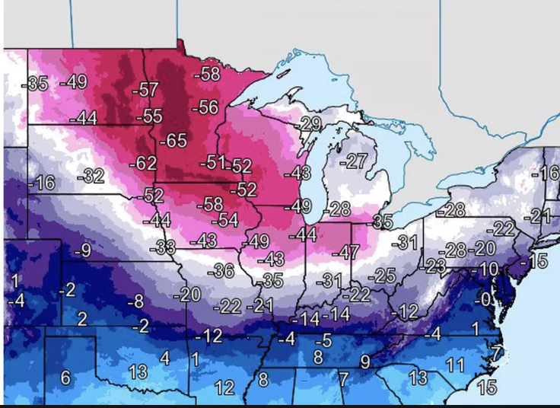
Yearly Temperature (Annual Average Max Temp) Data
Yearly PM 2.5 Data

Slide 10
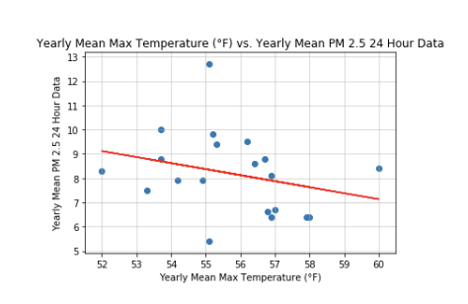
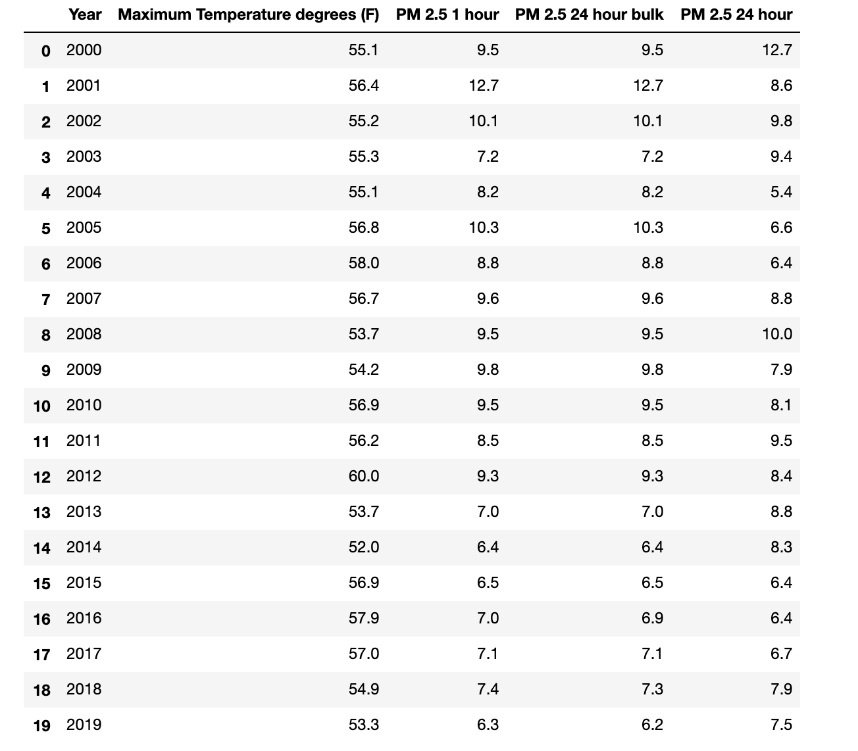
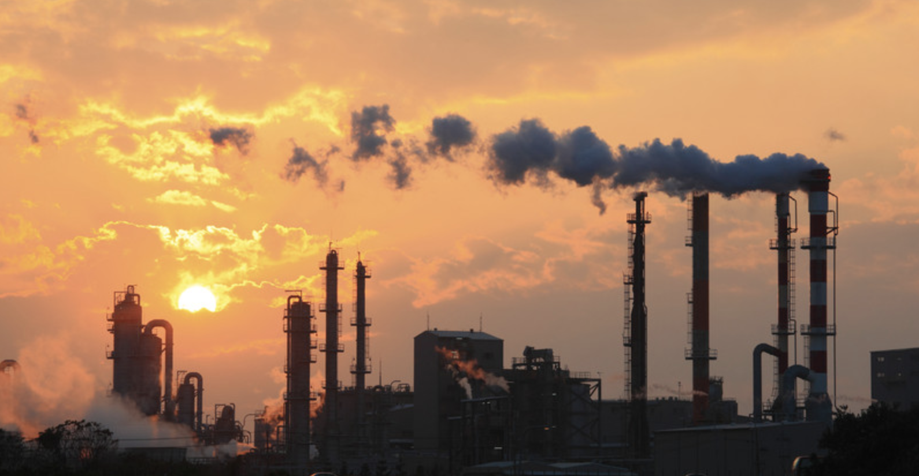
The r-value is: -0.28

Slide 11
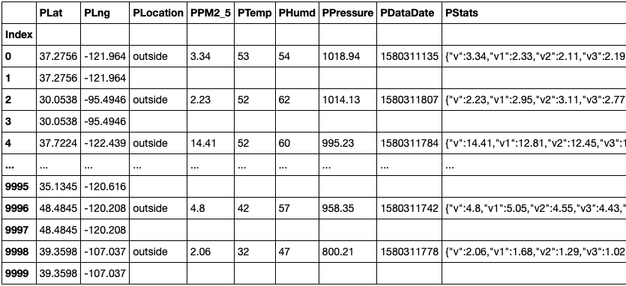
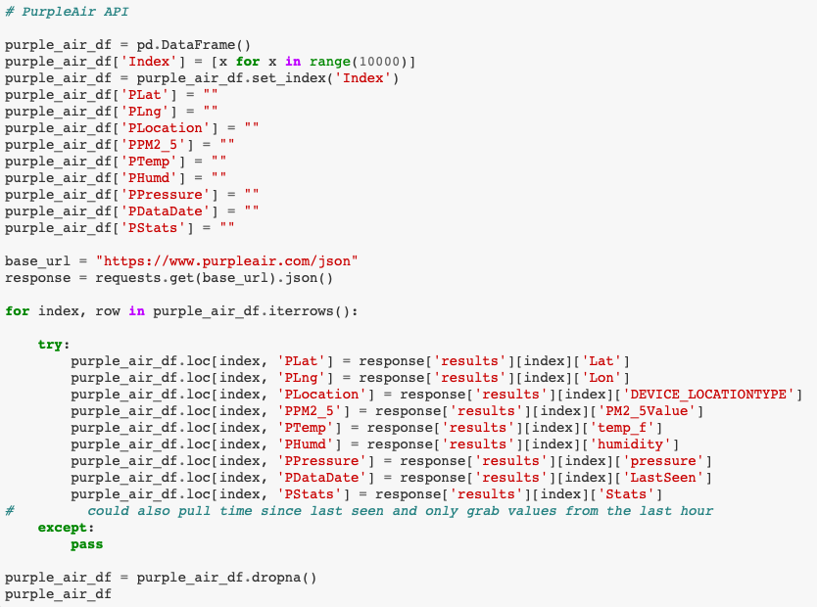
Purple Air Data – API request

Slide 12
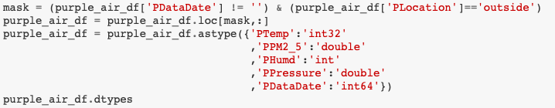
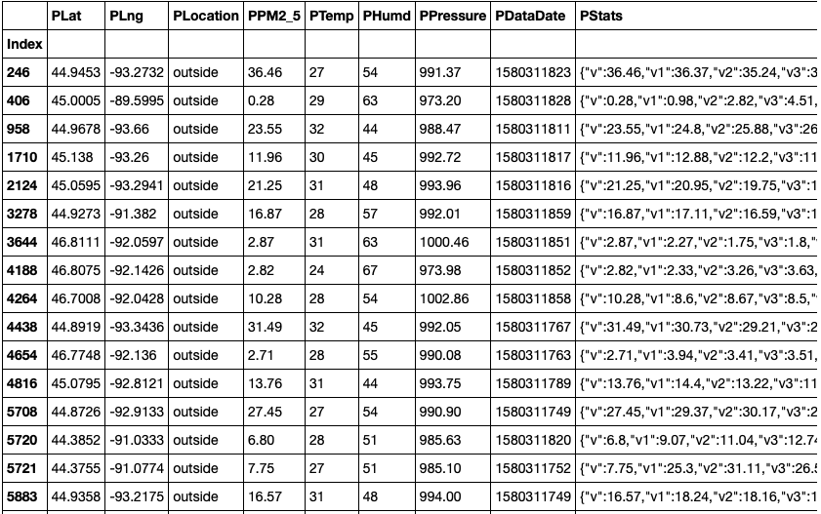
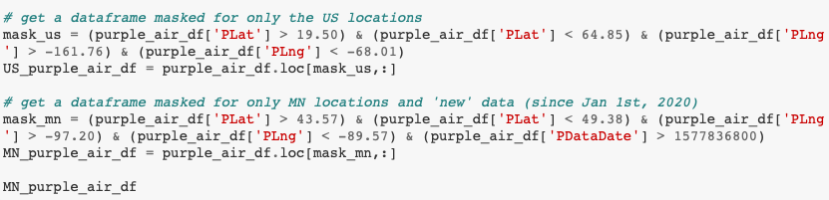
Purple Air Data – data cleaning

Slide 13
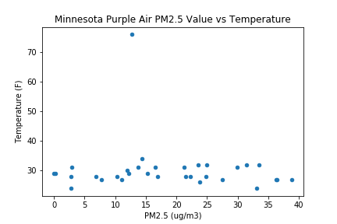
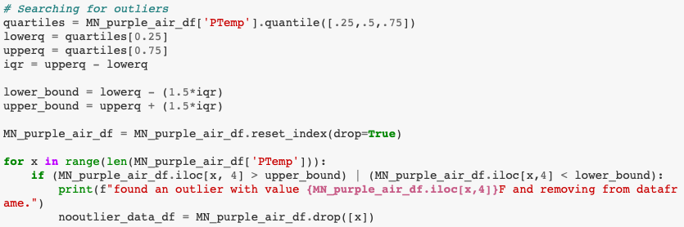
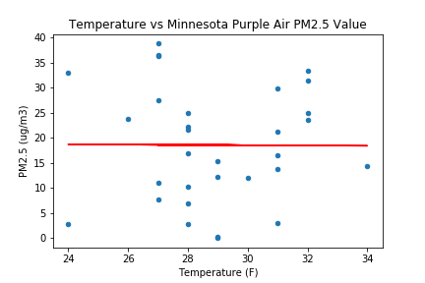
Temperature vs PM2.5 in MN From Purple Air
R value = -0.0059

